Slide 1
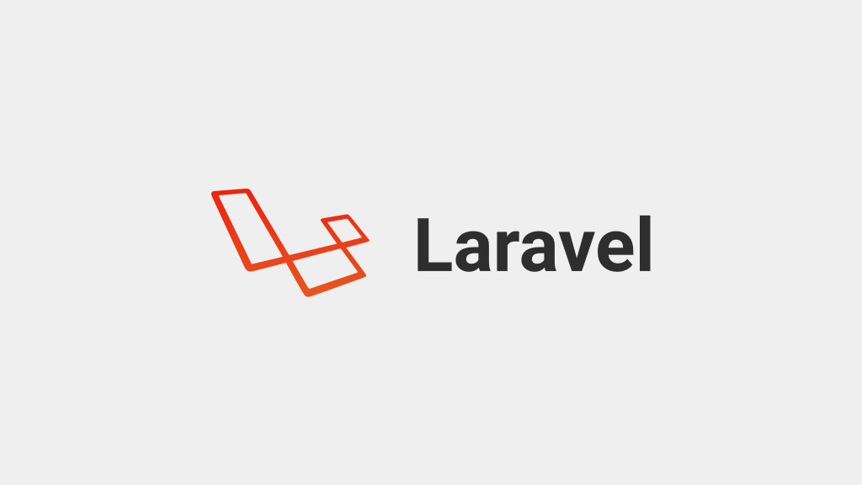

Slide 2

Mail Lec 11
Generating Mail
Mail config ENV
Driver Prerequisites
Mail Driver

Slide 3
Generating Mail php artisan make:mail -h
Description:
Create a new email class
Usage:
make:mail [options] [--] <name>
Arguments:
name The name of the class
Options:
-f, --force Create the class even if the mailable already exists
-m, --markdown[=MARKDOWN] Create a new Markdown template for the mailable
-h, --help Display this help message
-q, --quiet Do not output any message
-V, --version Display this application version

Slide 4
Driver Prerequisites
composer require guzzlehttp/guzzle

Slide 5
MailGun Driver

